Slide 1
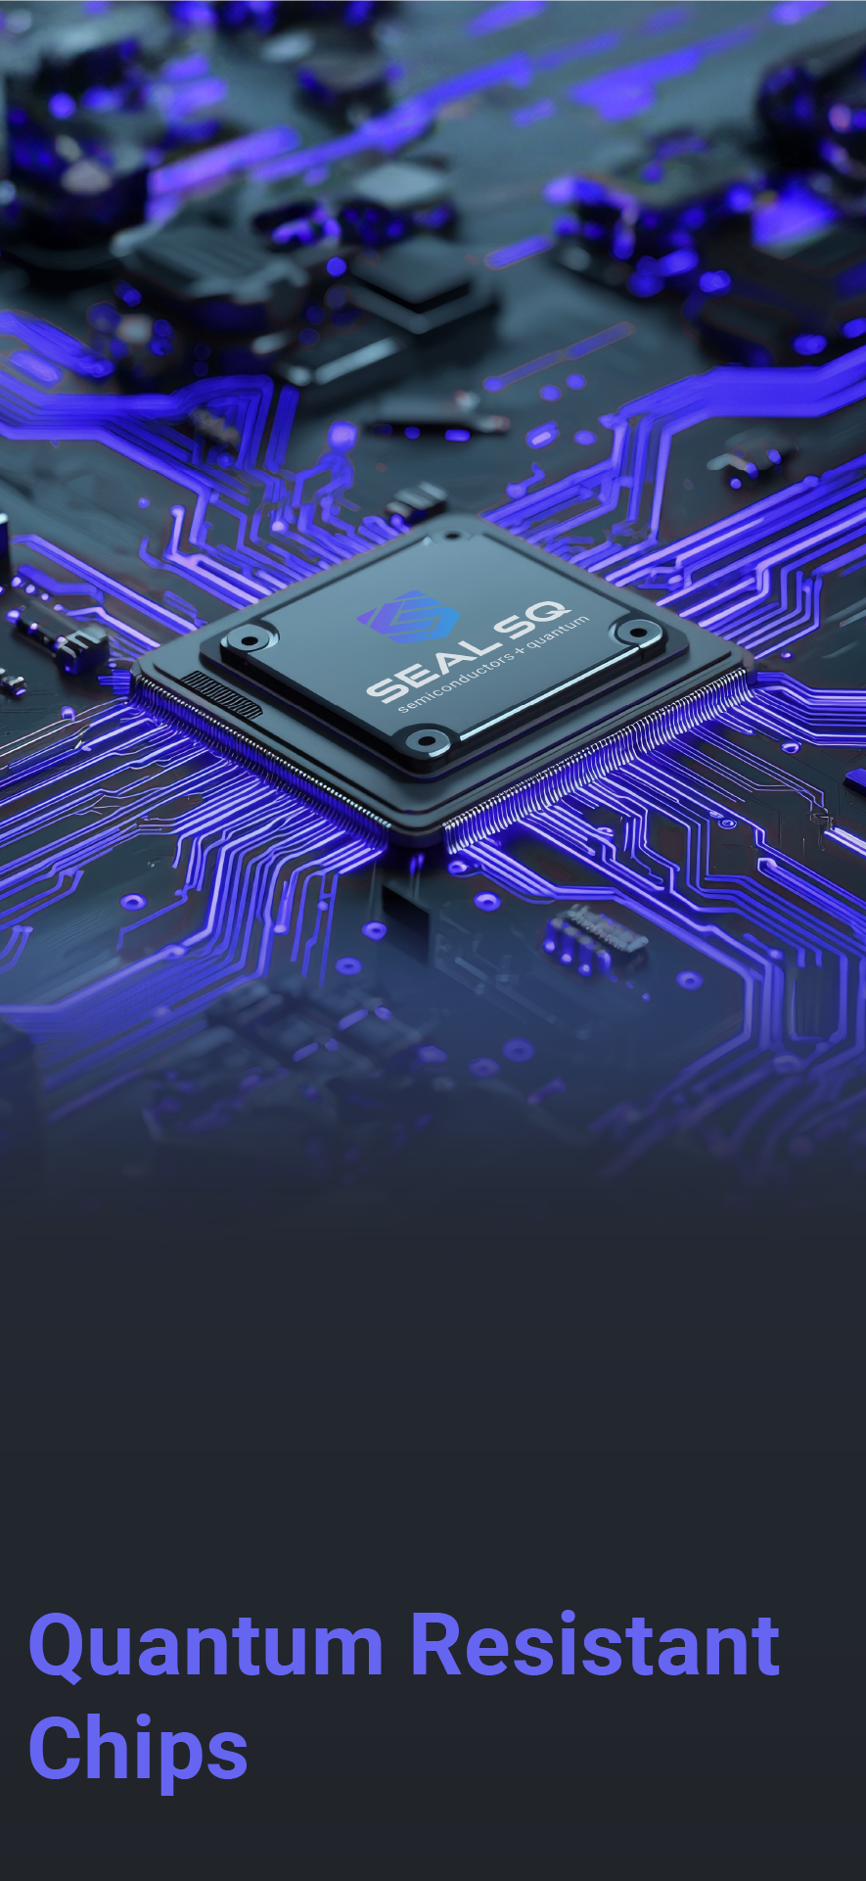
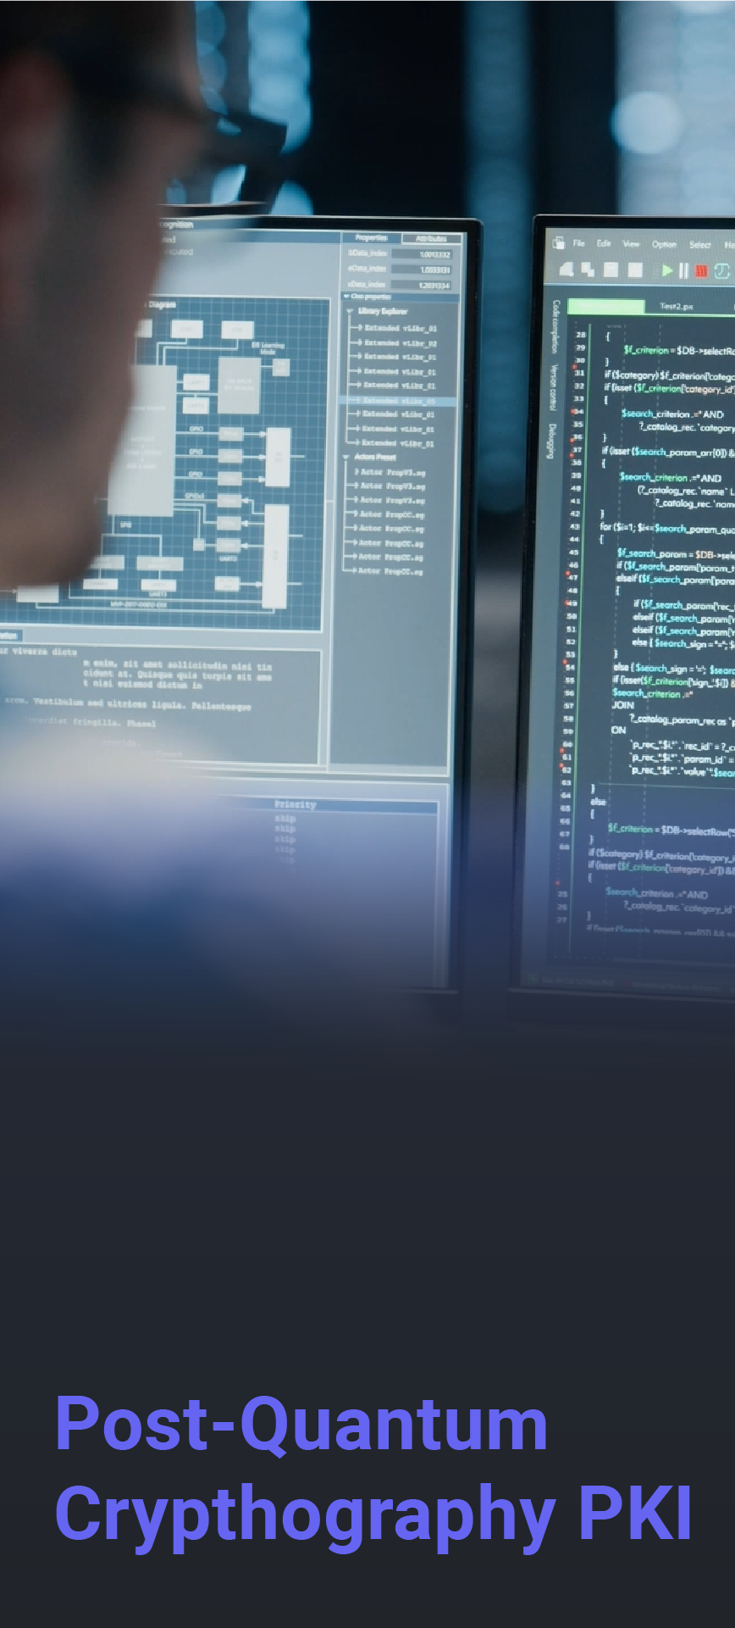
Investor Presentation
May 2025
End-to-End
Post Quantum
Security Solutions

Slide 2
Forward-Looking Statements
This communication expressly or implicitly contains certain forward-looking statements concerning SEALSQ Corp and its businesses. Forward-looking statements include statements regarding our business strategy, financial performance, results of operations, market data, events or developments that we expect or anticipates will occur in the future, as well as any other statements which are not historical facts. Although we believe that the expectations reflected in such forward-looking statements are reasonable, no assurance can be given that such expectations will prove to have been correct. These statements involve known and unknown risks and are based upon a number of assumptions and estimates which are inherently subject to significant uncertainties and contingencies, many of which are beyond our control. Actual results may differ materially from those expressed or implied by such forward-looking statements. Important factors that, in our view, could cause actual results to differ materially from those discussed in the forward-looking statements include SEALSQ's ability to continue beneficial transactions with material parties, including a limited number of significant customers; market demand and semiconductor industry conditions; and the risks discussed in SEALSQ's filings with the SEC. Risks and uncertainties are further described in reports filed by SEALSQ with the SEC.
SEALSQ Corp is providing this communication as of this date and does not undertake to update any forward-looking statements contained herein as a result of new information, future events or otherwise.
2

Slide 3
Financial Highlights & Outlook
Strategic Initiatives
Strong Commitment to ESG
Who We Are
How We Compete
Appendix – Historical Financials

Slide 4
About SEALSQ
SEALSQ develops and sells
Semiconductors, PKI and Post-Quantum technology hardware and software products
SEALSQ Corp.
Established | 1998 (acquired by WISeKey, parent company of SEALSQ in 2016 and reorganized in 2022)
Headquarters | France
Employees | ~60 total
 | ~25 R&D focused
Client base | 30+ countries
Patents | 118 security related
Certifications
Data as of May 2025
Nasdaq listed | May 2023
Ticker symbol | LAES
Shares Outstanding
Ordinary Shares | 114.5 Million**
F shares * | 1,499,700 (plus 77 warrants)
Stock price | $2.44/share
Market cap | $280 million
* In terms of dividend rights, 1 F share is equivalent to 5 Ordinary shares ** Data as of May 14, 2025
4

Slide 5
SEALSQ: Investment Highlights
Major Initiatives
Four major strategic initiatives to drive growth and profitability in 2025 and beyond
Launch of post-quantum chips
Expand global presence through Open Semiconductor Test and Personalization (“OSPT”) Centers
Investment into quantum companies
Satellite connectivity in collaboration with WISeSat.Space
Investing in the Future
Made significant progress in strategic transformation to post-quantum market leader.
Further expanded global client base with a focus on increased presence in U.S.
Introduced a variety of new products and services; taping into new revenue streams.
R&D investments; ambitious roadmap to launch next generation post-quantum chips in 2025.
Targeting Acquisitions
In exclusive negotiations to acquire IC ALPS, an ASIC design and supply specialist based in Grenoble, France.
Strong Cash Balance
$85M at 12/31/2024
R&D Investments
Continued investments in post-quantum chips
Investing in Start-ups
$20M Allocated
Targeting Acquisitions
In exclusive negotiations with IC ALPS

Slide 6
SEALSQ at a Glance
One-stop-shop provider
Offering a fully integrated vertical suite of microcontrollers and trust services
Securing any kind of connected devices and systems
Customer Benefits
The only digital security company acting as…
OEM
Achieve easy, fast & cost-effective product compliance with major standards (Matter, US Cyber Trust Mark, FIPS, CE...).
Ensure product and data Integrity, Authenticity and Confidentiality.
Securely provision devices with trusted identities on premises or remotely at any scale.
Operators & Service Providers
Easily and securely manage assets & users identity lifecycle at any scale.
Securely collect data from endpoints (sensors, devices, gateways).
Connect with sensors anywhere on earth using pico-satellite connectivity.
Full range of FIPS & Common Criteria Certified Secure microcontrollers.
A managed PKI-aaS platform combined with trusted hardware provisioning services.
European independent Root-of-Trust featuring a Matter PAI and WISUN accredited Root of Trust.
A cutting-edge R&D roadmap to develop certified chips running Post-Quantum algorithms and a Post Quantum Root of Trust.
Brands
Prevent counterfeiting & enable authentic Consumer Engagement.
Mint device identities into trusted blockchains creating NFTs.
6

Slide 7
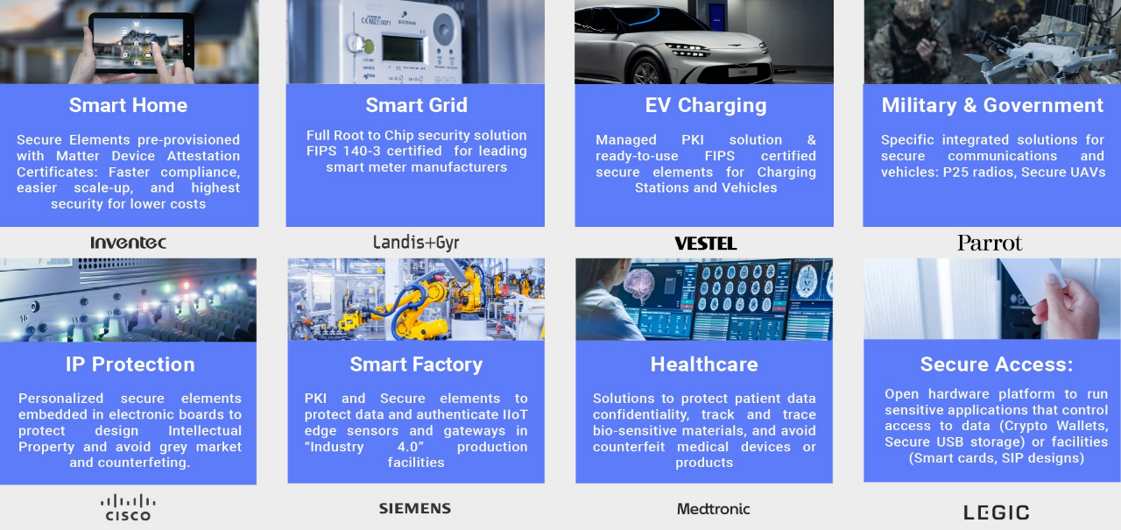
Use Cases: Markets We Serve
7

Slide 8
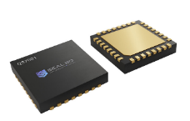
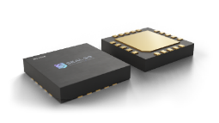
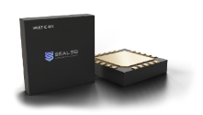
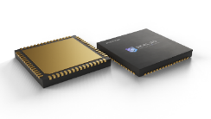
SEALSQ Semiconductor & Embedded Software
APPLICATIONS
Post Quantum Chips
Secure Storage
Access Control
Custom Application
TPM: PC, Tablets, Industrial
CCEAL 5+ RISC V Quantum Resistant Hardware platform with an optional TPM Stack firmware
MS600X FAMILY
Secure Storage
Access Control
Custom Application
CC EAL 5+ Certified Secure Controller family delivered with SDK for OS development
VaultIC FAMILY
CC EAL4+ & FIPS 140-3 Certified Secure Controller family with Embedded Firmware designed for IoT strong authentication & secure com’ channel
IoT Security
Device to Device Auth.
Device to Cloud Auth.
SCR FAMILY
POS terminals
Portable readers
NFC enabled devices
Full range of chips to build Smartcard readers

Slide 9
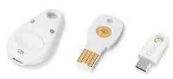
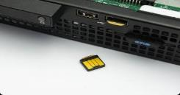
New TPM Target Markets
TAM: 500M$
CAGR: 15%
PC & Laptops
Tablets
USB Authentication Dongles
Data Storage
Hardware Security Modules (HSMs)

Slide 10
Where We Stand Today
3 Years TPM Engaged or Confirmed Client Pipeline
100
Engaged Clients
>80
Engaged
Clients
Today
2025 Target

Slide 11
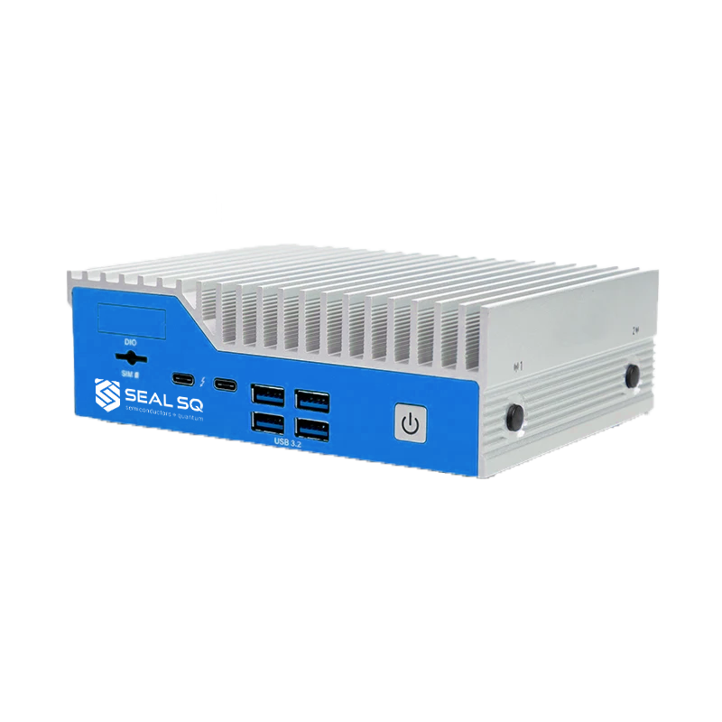
SEALSQ Quantum Resistant Trust Services
In 2024, NIST finalized the selection of several quantum-resistant cryptographic algorithms to be used as standards
(for instance, Crystals-Kyber or Crystals-Dilithium)
SEALSQ has developed a Quantum Root-of-Trust and is…
Using these cutting-edge algorithms within its PKI services.
Can operate seamlessly on classical hardware, ensuring compatibility with current devices and systems

Slide 12
SEALSQ Technology Roadmap
1. IP and ASIC Offer
We are identified as a Product supplier
We want to penetrate the “IP Player” market
(we already have 3 prospects)
2. Advancing to smaller and faster technology nodes (assessment):
(1/10,000 hair ) (/2) (/3)
3. Javacard- PQC Ready offer (assessment):
Enabling developer community
55nm Flash
28nm Flash
22/14 nm ReRam
Notes:
INSIDE Contactless
5/15/2025
www.insidecontactless.com
12

Slide 13
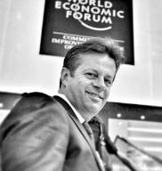
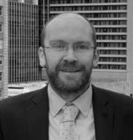
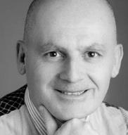
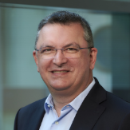
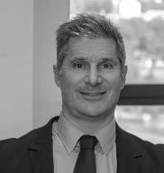
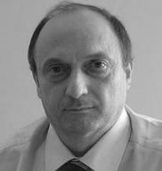
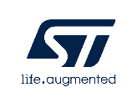
Highly Qualified Management Team
Carlos Moreira
Chief Executive Officer
John O’Hara
Chief Financial Officer
Bernard Vian
GM – SEALSQ France
Frank Buonanno
VP - Global Sales
Jean-Pierre Enguent
VP - R&D Systems and Solutions
Loïc Hamon
Chief Operating Officer
13

Slide 14
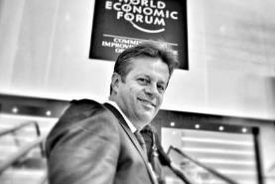
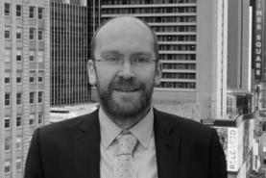
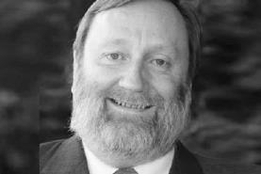
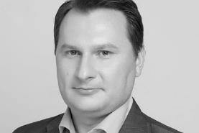
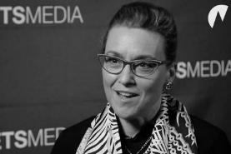
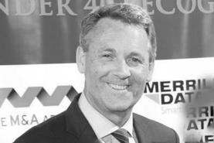
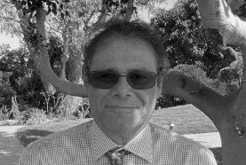
BoD With a Wide Array of Backgrounds and Experience
Carlos Moreira
Chairman, Executive Director
John O’Hara
Executive Director
Peter Ward
Non-Executive Director
Ruma Bose
Non-Executive Director
Danil Kerimi
Non-Executive Director
Christina Dolan
Non-Executive Director
David Fergusson
Non-Executive Director
Eric Pellaton
Non-Executive Director
14

Slide 15
Financial Highlights & Outlook
Strategic Initiatives
Strong Commitment to ESG
Who We Are
How We Compete
Appendix – Historical Financials

Slide 16
Value Proposition & Key Differentiators
Post-Quantum Technology
Digital Security PURE Player
Customization / ASICS
Quantum-resistant chips in 2025, and post-quantum algorithms already running for PKI
We focus only on security, unlike our biggest hardware competitors who specialize in a broad range of embedded components.
SEALSQ designs and delivers tailor-made chips to meet the specific performance and security needs of its clients.
Quantum Root-of-Trust
Digital Security FULL Player
Fabless
Swiss-based Quantum Root of Trust, accredited by numerous industry ecosystems or standards such as WebTrust, Matter, GSMA and Wi-SUN
The only market player integrating all aspects of a connected device’s security from the Root-of-Trust to the Secure Elements
Cost-efficient, flexible business model focusing on the core profit area of the value chain (semiconductor design & trust services).

Slide 17
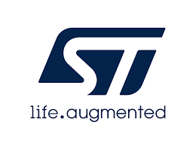
Competition Mapping on Embedded Security
(Software & Hardware)
Embedded Security Provider
IP, Software Security
(Trust Zone
& TEE)
Hardware with certified Lab
(TPM, SE)
1
2
3
Broadliner
Chip Maker
X
Ranking in Market Share
17

Slide 18
Competition Mapping on Trust Services
IoT Device Identity Provider
Pure Software Players
1
Legacy (Public CA & PKI
2
3
4
Broadliner
(Corporate / User / Device)
X
Ranking in Market Share
18
18

Slide 19
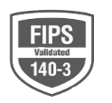
Barriers to Entry & Alliances: SEALSQ is Ahead of the Game
Standards / Consortiums
Certifications mandated by cybersecurity regulation bodies
GSMA selects only 2 Root CA / PKI, WISeKey accredited to start business in 2024.
More on MATTER: https://csa-iot.org/certification/paa
For SECURITY IC market, SEALSQ products have passed certifications like FIPS 140-3 or Common Criteria.
For PKI and Certificates, certification is WEBTRUST.
19

Slide 20
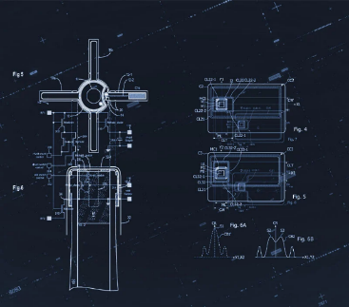
Still true?
SEALSQ Holds Over 100 Active Patents
100+ active patents, bringing innovation to markets like
Near Field Communication (NFC) technology, Banking Cards, Pay TV, Health Cards, etc.
39
106
17
Patent Families
Granted Active Patents
Pending Patents
20

Slide 21
Financial Highlights
Strategic Initiatives
Strong Commitment to ESG
Who We Are
How We Compete
Appendix – Historical Financials

Slide 22
Major Strategic Initiatives
1
2
3
4
QUASAR
Program
OSPT
Centers
Investment in Quantum Companies
Satellite
Connectivity
Full range of quantum resistant semiconductors to be launched in 2025
Establish High-performance chip design & customization centers
20M$ Fund to invest in Quantum-Tech companies
Cost-effective IoT solutions for industrial applications
22

Slide 23
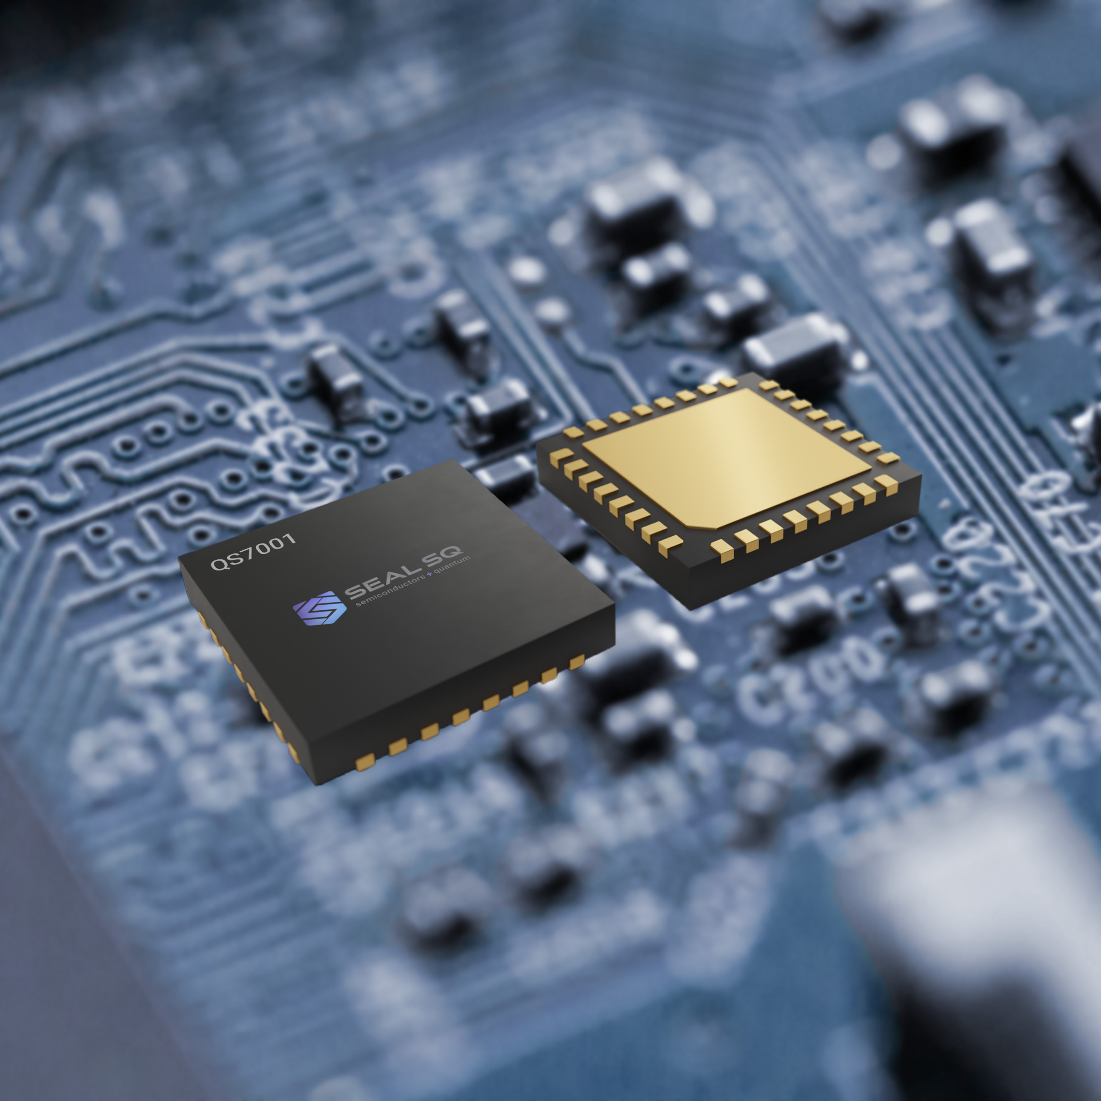
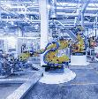
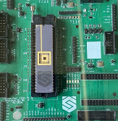
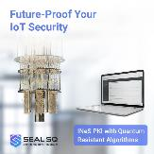
SEALSQ: Post-Quantum Services
1
Post-Quantum Semiconductor &
Embedded Software
Secure Identity Provisioning Services
Full range of Quantum Resistant chips built on a RISC-V Common Criteria Certified hardware architecture
Includes a TPM 2.0, FIPS 140-3 Compliant
ON WAFER
ON CHIP
IN FACTORY
IN THE FIELD
Quantum Root-of-Trust
Quantum Resistant Trust Services
SEALSQ is using cutting-edge algorithms selected by the National Institute of Standards and Technology (NIST) in 2024 within its PKI services.
Experienced
20 years issuing Digital Identities
Served over 3,000 corporate or gov. clients
Ubiquitous trust in browsers & operating systems
Accredited
Compliant with Major Standards & Alliances:
Flexible
Versatile PKI as-a-Service &
SSL Certificate Platforms
Easy to Deploy & Scalable

Slide 24
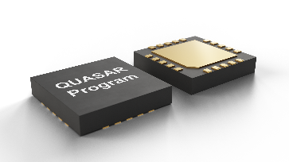
1
SEALSQ QUASAR Program
New Secure Chip
New PQ CRYTPO Engine
Firmware Update
RISC-V CPU
A new “Power engine”
2x faster than competition
KYBER
DILITHIUM
Fault Resistant Firmware Loader
Adaptation / Customization
at software level
24

Slide 25
1
QUASAR Roadmap
TPM & IoT Market
TPM standard was originally thought and designed for PC
(Hard Drive encryption, boot pw storage)
WINDOWS™ 11 made TPM standard mandatory for the PC world
Demand for TPMs is primarily driven by utilities/industrial IoT (IIoT) and connected car applications
Massive addressable market
for IoT cybersecurity
12 B devices 27 B devices
(connected in 2021) (expected to be connected by 2025)
CAGR: 22%
550 M units *
(TPMs connected in 2023)
CAGR: 33.4% **
* (EUROSMART association – Secure Elements Global market estimates)
** (ABI Research – “Which Security Solutions Are Being Used to Curb the IoT Cyber Risk?”, Sept 2023)
*** (“State of IoT – Spring 2022”, IOT Analytics, May 2022 )
25

Slide 26
1
QUASAR Roadmap (continued)
A New Business Model
CHIPLET AND CUSTOM ASIC
With the QUASAR program, we enter the MCU market with fuller processing capabilities and the possibility of programming the software to preform different tasks.
PQ HARDWARE PKI CRYPTO
CPU RAM
Analog Platform
PMU
HARDWARE PKI CRYPTO (ECC)
VCC, GND
CRYPTO RAM
Securities
USB DPRAM
FLASH
SECURE RISCV
Peripherals
USB
SECURE RISCV
WL RAM
Timer0
USB
Timer1
SPI
SPI
System Control
Interrupt Controller
GPIO
2 GPIOs
VFO
Clock Control
Power Control
433 M units *
(MCUs connected in 2023)
CAGR: 65.1%
COM IPs
Reset Control
RNG & Crypto IPs
Protection Control
RNG
CRC
AES
RTC
* ABI Research –Embedded Security for IoT, March 2020
26

Slide 27
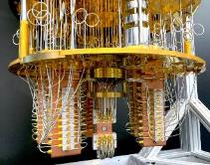
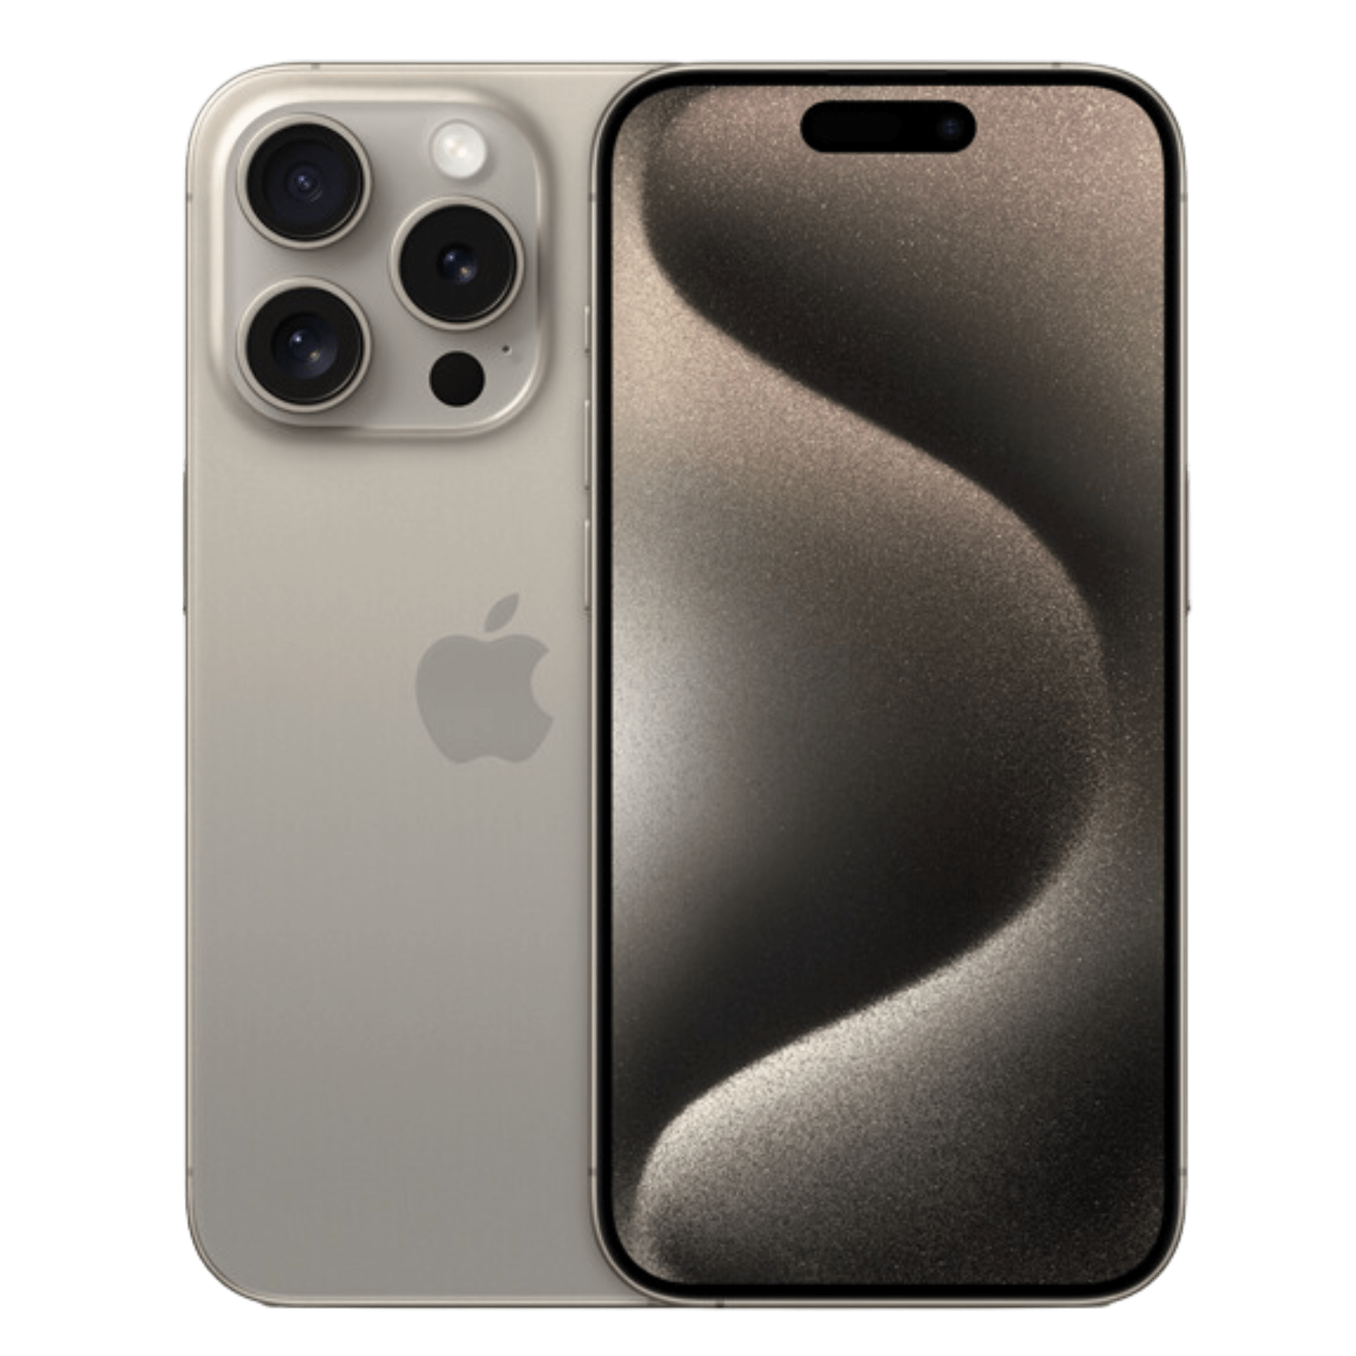
1
Evolution of Cryptographic Algorithms & Standards
Pivotal Period of Transition
1977
RSA
1992
ECDSA
2015
SHA-3
2023
Kyber & Dilithium PQC algorithms selected by NIST²
2030
PQC mandatory by ANSSI³
1991
DSA
1994
Shor’s
algorithm
2023
Google reporting it completed computational task on a quantum computer that would take a classical supercomputer 47 years to complete¹
2025
ANSSI recommend hybrid crypto³
Cryptography…
Quantum Computers…
Post Quantum Cryptography
Current asymmetric cryptographic algorithms: RSA, ECDSA…
Quantum computers will be
able to break current
asymmetric cryptographic algorithms
by using Shor’s algorithm⁴
Post Quantum Cryptography
claims to be
resistant against quantum computers⁵
https://thequantuminsider.com/2023/07/04/google-claims-latest-quantum-experiment-would-take-decades-on-classical-computer/,
https://csrc.nist.gov/Projects/post-quantum-cryptography/selected-algorithms-2022,
https://cyber.gouv.fr/sites/default/files/2022/04/anssi-avis-migration-vers-la-cryptographie-post-quantique.pdf,
Shor, P.W. (1994). "Algorithms for quantum computation: Discrete logarithms and factoring". Proceedings 35th Annual Symposium on Foundations of Computer Science. IEEE Comput.,
https://www.nccoe.nist.gov/crypto-agility-considerations-migrating-post-quantum-cryptographic-algorithms
27

Slide 28
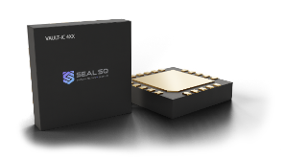
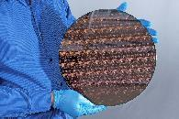
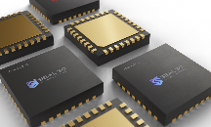
2
Semiconductor Design & OSPT Centers
Design Center
OSPT Centers
Added Value
Added Value
Design customer specific microcontrollers (ASIC, ASSP)
Automotive grading
Software and Digital Identity injection at Chip Module level
Differentiation
Differentiation
ROOT CA certified by WI-SUN, GSMA, MATTER
Common Criteria certified
Secure Design Expertise & Certification: Common Criteria, FIPS, NIST Post Quantum
Competitive Open-Source RISC-V technology
Growth Drivers
Service other semiconductor players
28

Slide 29
2
Semiconductor Design & OSPT Centers
Personalization Centers
Added Value
Differentiation
Software and Digital Identity injection at Chip Module level
ROOT CA Certified by:
Growth Drivers
Connected devices compliance with standards
Matter, Zigbee, ETSI EN 303 645, NIST IR 8425, US Cyber trust Act, EU Cyber-resilience Act
Common Criteria Certified by:
29

Slide 30
2
Semiconductor Design & OSPT Centers
OSAT Centers
SEALSQ offers countries the ability to develop their own OSPT Centers through Public-Private Partnerships (PPP).
OSPT Centers focus on local manufacturing to meet the highest standards of security and certification like Common Criteria and NIST.
Governments, including the US and EU, are currently establishing incentives to increase supply chain resilience, emphasizing the critical timing of SEALSQ’s initiative.
France
Established
United States
Under Negotiation
Spain
Asia / Middle East / Other
30

Slide 31
2
Semiconductor Design & OSPT Centers
Spain – Murcia
An International Benchmark in Cybersecurity
In collaboration with parent company WISeKey, SEALSQ is one of three parties selected for the ambitious project of creating of a high-performance OSPT Center in the Region of Murcia.
Joining forces with Odin Solution and T-Protégé in an innovative and international partnership.
The project foresees financing of €40M for its execution.
Will leverage Spain’s Strategic Project for the Economic Recovery and Transformation of Microelectronics and Semiconductors (PERTE Chip) initiative (aims to mobilize 12.25 billion euros by 2027).
Will offer personalized and secure solutions to customer needs.
Will benefit the industrial sector, public administration, and citizens, facilitating access to advanced technologies and improving the cybersecurity of critical systems.
Will create a pole of quality employment and a decisive boost to R&D.
31

Slide 32
2
Semiconductor Design & OSPT Centers
Expansive Target Markets
IoT Device
Market
TPM
Market
Secure Microcontroller Market
(includes automotive)
27 Billion units by 2025
3-year CAGR of 22%
(IOT Analytics, May 2022 )
$12.6 Trillions
economic value by 2030
(McKinsey Nov. 2021)
Applications:
utilities/industrial IoT (IIoT) and connected cars
356 Million units in 2023
Grown at CAGR of 33%
(ABI Research. 2023)
433 Million units in 2023
Grown at CAGR of 33%
(ABI Research –March 2020)
32

Slide 33
SEALSQ Investment Roadmap
3
$20M
Allocated to
startup investments
Targeting
Quantum computing
Quantum-as-a-Service (QaaS)
AI-driven semiconductor technologies
First investments
Already announced
Quantum Software-as-a-Service

Slide 34
WeCan Group Investment
3
Agreement to Acquire 30% Stake:
Founded in 2015 in Switzerland, WeCanGroup is a leading provider of blockchain-based solutions for secure data management, serving individuals, enterprises, and financial institutions.
Bolsters WeCan’s KYC/KYB platforms with advanced security for finance.
Enhances SEALCOIN’s IoT transaction ecosystem with compliance tools.
Expands into banking & wealth management via WeCan’s Swiss network.
Strengthens SEALSQ’s Web 3.0 foothold
Key Synergies:

Slide 35
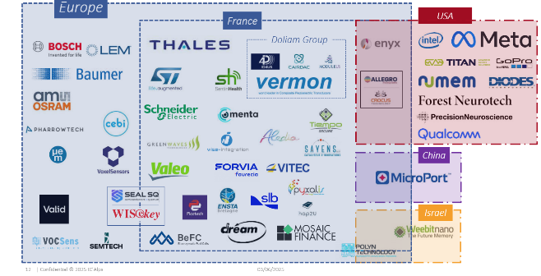
Exclusive Agreement to Acquire 100% of IC’ALPS
3
Currently in the due diligence in progress: Target to complete acquisition in Q2 2025
About
On-demand ASIC/SoC design and supply company
100+ experienced design engineers based in France (Grenoble & Toulouse)
Established long-term customers in healthcare, automotive & industry 4.0
Listed as recommended design partner by major foundries (TSMC, Intel, Xfab, OSRAM)

Slide 36
Strategic Synergies with IC’ALPS
3
Products
Speeds up SEALSQ quantum-resistant ASICs & off-the-shelf product roadmap.
Supply Chain
Combines IC ALPS footprint at Foundries with SEALSQ industrialization capabilities (packaging, test, personalization).
Customers
Leverages IC'ALPS’ footprint in Automotive & Healthcare to expand SEALSQ’s market reach.
Enrich IC’ALPS offering with quantum resistant secure designs to address Secure MCU market.
Opens doors for IC’ALPS design services across SEALSQ IoT customer base.
Market Share
Positions the Company as a major player in the Secure IC Market in Europe (custom or off-the shelf) by covering the full value chain from design to delivery & trust services.

Slide 37
4
Satellite Connectivity
In Collaboration with WISeSat.Space
SEALSQ, in collaboration with WISeSat.Space, are developing the first cost effective and secure IoT connectivity solution anywhere on Earth, using picosatellites and low-power sensors.
Current Problem
SEALSQ Solutions
Costly connectivity gap for a growing number of connected devices.
Global cost-effective solutions for a wide variety of applications including livestock, wearables, agriculture, industrials, tracking, to name a few.
~80%
Terrestrial connectivity gap
Use Cases
Smart Agriculture & Farming
Water management & optimization, livestock location & illness detection, analytic predictions
+25B
IoT connected devices (2030)
Logistics with Smart Container
Traceability, food chain audits, tracking
Costly, Inefficient & Complex
Current solutions
Infrastructure
Galvanic corrosion, voltage & current, vibrations

Slide 38
4
Satellite Connectivity: Progress
In Collaboration with WISeSat.Space
Container Tracking Advancements
Next Generation Satellites
Two major agreements were announced in 2024 that accelerate the real-life execution of SEALSQ’s container tracking capabilities.
SEALSQ, in collaboration with WISeSat.Space, is set to launch six new next-generation satellites in 2025.
Each satellite will feature incremental advancements in post-quantum cryptography and secure communication technologies.
Bernardino Abad Grupo Logístico
Agreement signed to become the first reference for the Smart Container platform and sensors, driving the future of logistics.
First satellite launched in January 2025.
Tránsitos y Transportes Logísticos
Proof of Concept agreement signed leveraging Smart Container platform and sensors for advancement in the transportation space, marking significant set towards digitalization transport operations.
Part of initiative to leverage SEALSQ’s post-quantum semiconductors to establish a secure, scalable, satellite constellation.

Slide 39
Financial Highlights & Outlook
Strategic Initiatives
Strong Commitment to ESG
Who We Are
How We Compete
Appendix – Historical Financials

Slide 40
FY 2024 Financial Overview
As expected, 2024 was a transitional year given:
Excess inventories at legacy customers
Customers and prospects awaiting availability of next-generation chips
Impact of global economic slowdown
FY 2024 performance was reflected of this slowdown, but also of the resilience of SEALSQ to adapt to ever changing technology standards.
The Company is well positioned to capitalize on pre-shortage demand from legacy customers and new business opportunities, expected to materialize in 2025.
$11M
Revenue
FY 2024 (unaudited)
$85M
cash reserve
at December 31, 2024
Entirely clean
balance sheet
no warrants / no convertible debt
$5M
R&D Investments
In FY 2024
$7.2M planned for FY 2025

Slide 41
2025 Outlook
Bookings +80%
vs. same time in prior year
$93M pipeline
Potential contracts
OSPT projects
At least one agreement expected to
be signed in H1 2025
>80 active engagements
On new post-quantum TPM product opportunities

Slide 42
Strategy for 2025 and Beyond
Quantum Roadmap $20M investment in multiple Quantum companies Goal Identify opportunities to integrate our technologies and enhance our Quantum Roadmap
Expand
US Presence
OSPT projects
More agreements expected to be signed in the coming years
Post-Quantum TPM Opportunities

Slide 43
Opportunity to Gain Market Share
Large, Growing Market
Breakdown by Segment
Secure Microcontroller
Wearables
+32%
20.2%
CAGR
Smart Home (Matter)
+27%
M$ 2023
M$ 2024
Utilities & Industrial IoT
+33%
Smart Cities (Wi-Sun)
+32%
Other
+29%
PC Devices & Digital Home
-6%
0
200
400
600
800
1000
Significant growth expected to be driven by demand for digital security in technologically-advancing world.
SEALSQ well-positioned to secure the rapidly growing IoT ecosystem across industries.
Geographically well-positioned as well, as largest market opportunities are expected in Europe and United States.
TPM
Smart Cities & Buildings
+31%
Connected Car
+21%
Utilities & Industrial IoT
+30%
PC Devices & Digital Home
+3%
0
50
100
150
200
250
43
Source: https://www.marketsandmarkets.com/Market-Reports/public-key-infrastructure-market-145372975.html?gad_source=1&gclid=CjwKCAjw88yxBhBWEiwA7cm6pW0PykImoRR90NW3nt6wnO2RUAQIiC2xyQpNDUE7yIhy-A6aI_mXYBoCvncQAvD_BwE

Slide 44
Financial Highlights & Outlook
Strategic Initiatives
Strong Commitment to ESG
Who We Are
How We Compete
Appendix – Historical Financials

Slide 45
Strategic ESG Principles
Social Responsibility
Commitment to ensure widespread awareness among individuals within the organization, extends beyond the workplace. Fosters an inclusive and responsible corporate culture, that contributes into the well-being of employees and society at large.
Environmental Stewardship
Vigilant environmental monitoring system to ensure compliance with and anticipation of all applicable laws and standards; emphasis on reducing carbon footprint through a systematic and accountable approach.
Strategic Deployment
Implements a strategic perspective throughout the entire organization by promoting activities based on the Plan-Do-Check-Act (PDCA) cycle and embedding environmental responsibility into core business strategies.
Global Compliance & Innovation
Proactively implements global compliance measures to ensure adherence to existing regulations; at the forefront of emerging environmental standards, fostering innovation and sustainable business practices.
Governance Excellence
Reinforces a governance framework that aligns with international standards. Ensures transparency, accountability, and ethical conduct, integrates environmentally sustainable practices across all levels, and supports responsible business practices.
45

Slide 46
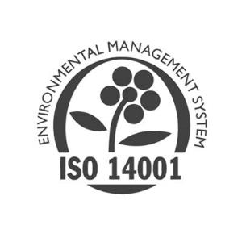
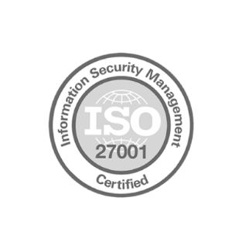
Certifications in Quality, Security, and Impact
SEALSQ’s Environmental Management System has received the ISO 14001 label.
Quality is monitored and has been awarded the ISO 9001 label since 2007.
Operations are run under an ISO 27001 certified environment for Security.
SEALSQ’s Certificate Authority is Webtrust accredited; semiconductor chips are certified by the Common Criteria and FIPs, the most demanding certification bodies in the world.
46

Slide 47
Contact Us
SEALSQ Corp. Carlos Moreira Chairman & CEO info@sealsq.com
Investor Relations (US) The Equity Group Inc.
Lena Cati Tel: +1 212 836-9611
lcati@equityny.com

Slide 48
Financial Highlights
Strategic Initiatives
How We Compete
Who We Are
Market and Differentiators
Appendix – Historical Financials

Slide 49
Historical Consolidated Statements of Comprehensive Income/(Loss)
 | 12 months ended December 31,
USD'000, except earnings per share | 2024 |  | 2023 |  | 2022
Net sales | 10,981 |  | 30,058 |  | 23,198
Cost of sales | (6,775) |  | (15,589) |  | (13,267)
Depreciation of production assets | (478) |  | (420) |  | (132)
Gross profit | 3,728 |  | 14,049 |  | 9,799
Other operating income | 359 |  | 48 |  | 2,007
Research & development expenses | (4,985) |  | (3,946) |  | (2,308)
Selling & marketing expenses | (5,453) |  | (5,648) |  | (3,824)
General & administrative expenses | (10,840) |  | (8,644) |  | (3,091)
Total operating expenses | (20,919) |  | (18,190) |  | (7,216)
Operating (loss) / income | (17,191) |  | (4,141) |  | 2,583
Non-operating income | 1,061 |  | 2,442 |  | 935
Gain / (loss) on debt extinguishment | (100) |  | - |  | -
Interest and amortization of debt discount | (1,003) |  | (689) |  | (355)
Non-operating expenses | (883) |  | (655) |  | (638)
(Loss) / income before income tax expense | (18,116) |  | (3,043) |  | 2,525
Income tax (expense) / income | (3,085) |  | (225) |  | 3,245
Net (loss) / income | (21,201) |  | (3,268) |  | 5,770
Earnings per Ordinary Share (USD)
Basic | (0.60) |  | (0.21) |  | 0.41
Diluted | (0.60) |  | (0.21) |  | 0.41
Earnings per F Share (USD)
Basic | (3.01) |  | (1.07) |  | 2.04
Diluted | (3.01) |  | (1.07) |  | 2.04
Other comprehensive income / (loss), net of tax:
Foreign currency translation adjustments | - |  | (2) |  | (15)
Defined benefit pension plans:
Net gain / (loss) arising during period | (27) |  | 11 |  | 170
Other comprehensive income / (loss) | (27) |  | 9 |  | 155
Comprehensive (loss) / income | (21,228) |  | (3,259) |  | 5,925
49

Slide 50
Historical Consolidated Balance Sheets
 | As at December 31, |  | As at December 31,
USD'000, except par value | 2024 |  | 2023
ASSETS
Current assets
Cash and cash equivalents | 84,624 |  | 6,895
Accounts receivable, net of allowance for doubtful accounts | 3,825 |  | 5,053
Inventories | 1,418 |  | 5,231
Prepaid expenses | 355 |  | 605
Government assistance | 2,247 |  | 1,718
Other current assets | 593 |  | 765
Total current assets | 93,062 |  | 20,267
Noncurrent assets
Deferred income tax assets | - |  | 3,077
Deferred tax credits | 190 |  | -
Property, plant and equipment, net of accumulated depreciation | 3,201 |  | 3,230
Intangible assets, net of accumulated amortization | - |  | -
Operating lease right-of-use assets | 1,031 |  | 1,278
Other noncurrent assets | 82 |  | 83
Total noncurrent assets | 4,504 |  | 7,668
TOTAL ASSETS | 97,566 |  | 27,935
LIABILITIES
Current Liabilities
Accounts payable | 10,073 |  | 6,963
Notes payable | 4,828 |  | 1,278
Deferred revenue, current | 5 |  | -
Current portion of obligations under operating lease liabilities | 327 |  | 336
Income tax payable | 1 |  | 2
Other current liabilities | 283 |  | 138
Total current liabilities | 15,517 |  | 8,717
Noncurrent liabilities
Bonds, mortgages and other long-term debt | - |  | 1,654
Convertible note payable, noncurrent | - |  | 1,519
Indebtedness to related parties, noncurrent | 3,105 |  | 9,695
Operating lease liabilities, noncurrent | 616 |  | 893
Employee benefit plan obligation | 464 |  | 426
Total noncurrent liabilities | 4,185 |  | 14,187
TOTAL LIABILITIES | 19,702 |  | 22,904
50

Slide 51
Historical Consolidated Statements of Comprehensive Income/(Loss)
WISeKey Semiconductors SAS, SEALSQ Corp Predecessor Financial Statement for the year ended Dec. 31, 2022
 |  | 12 months ended December 31,
USD'000 |  | 2022 |  |  |  | 2021 |  |  |  | 2020
Net sales |  |  | 23,198 |  |  |  | 16,995 |  |  |  | 14,317
Cost of sales |  |  | (13,267 | ) |  |  | (9,547 | ) |  |  | (8,147 | )
Depreciation of production assets |  |  | (132 | ) |  |  | (301 | ) |  |  | (736 | )
Gross profit |  |  | 9,799 |  |  |  | 7,147 |  |  |  | 5,434
Other operating income |  |  | 2,007 |  |  |  | 91 |  |  |  | —
Research & development expenses |  |  | (2,308 | ) |  |  | (3,050 | ) |  |  | (4,128 | )
Selling & marketing expenses |  |  | (3,824 | ) |  |  | (4,245 | ) |  |  | (3,103 | )
General & administrative expenses |  |  | (3,091 | ) |  |  | (4,984 | ) |  |  | (6,788 | )
Total operating expenses |  |  | (7,216 | ) |  |  | (12,188 | ) |  |  | (14,019 | )
Operating income / (loss) |  |  | 2,583 |  |  |  | (5,041 | ) |  |  | (8,585 | )
Non-operating income |  |  | 935 |  |  |  | 483 |  |  |  | 146
Interest and amortization of debt discount |  |  | (355 | ) |  |  | (167 | ) |  |  | (8 | )
Non-operating expenses |  |  | (638 | ) |  |  | (96 | ) |  |  | (749 | )
Income / (loss) before income tax expense |  |  | 2,525 |  |  |  | (4,821 | ) |  |  | (9,196 | )
Income tax income (expense) |  |  | 3,245 |  |  |  | (6 | ) |  |  | (5 | )
Net income / (loss) |  |  | 5,770 |  |  |  | (4,827 | ) |  |  | (9,201 | )
Earnings per share (USD)
Basic |  |  | 3.92 |  |  |  | (3.72 | ) |  |  | (6.25 | )
Diluted |  |  | 3.92 |  |  |  | (3.72 | ) |  |  | (6.25 | )
Other comprehensive income / (loss), net of tax:
Foreign currency translation adjustments |  |  | (15 | ) |  |  | (8 | ) |  |  | 33
Defined benefit pension plans:
Net gain (loss) arising during period |  |  | 170 |  |  |  | 142 |  |  |  | 105
Other comprehensive income / (loss) |  |  | 155 |  |  |  | 134 |  |  |  | 138
Comprehensive income / (loss) |  |  | 5,925 |  |  |  | (4,693 | ) |  |  | (9,063 | )
51

