Slide 1
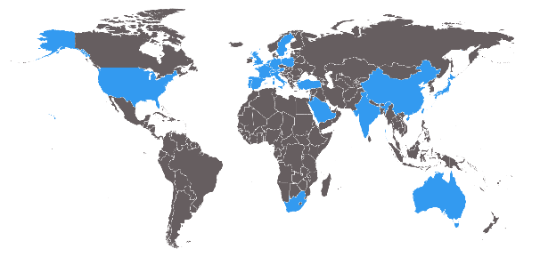
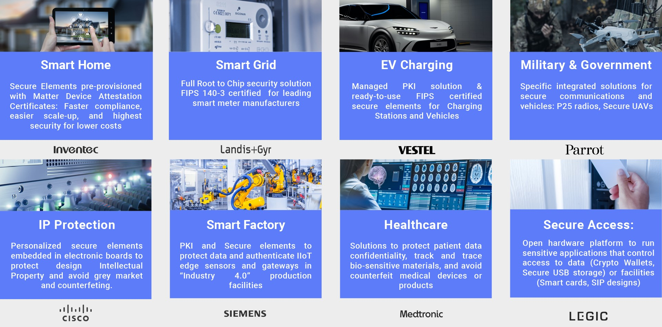
Factsheet – May 2025
About SEALSQ Corp:
Develops and sells Semiconductors, PKI and Post-Quantum
technology hardware and software products
Nasdaq listed | May 2023
Ticker symbol | Nasdaq: LAES
Shares Outstanding
Ordinary Shares | 114.5 million **
F shares * | 1,499,700 (plus 77 warrants)
Stock price | $2.50/share
Market cap | $280 million
* In terms of dividend rights, 1 F share is equivalent to 5 Ordinary shares Data as of May 14, 2025
25
Years
106
Granted Active Patents
30+
Countries
Certifications
Technology & Applications
Certificate Authority
Experienced
20 years in managed PKI operations
Served over 3,000 clients
Accredited
Compliant with major standards (Matter, GSMA, Webtrust…)
Flexible
Versatile PKI as a Service Platform
Public Key Infrastructure
Managed PKI-as-a-Service
Root of Trust (Cert. Authority)
SaaS platform (INeS)
APIs (AWS, Azure…)
Key Applications
Consumer IoT
Industrial IoT
Health & Public Services
Provisioning Services
SaaS Platform to provision trusted identities into secure semiconductors
Data Generation
Provisioning on Wafer
Provisioning on Package
CCEAL5+ Environment
Semiconductor & Embedded Software
MS-600X FAMILY
Secure Storage, Access Control, and Custom Application
VAULT-IC FAMILY
IoT Security, Device to Device Authentication, and Device to Cloud Authentication
SCR FAMILY
POS Terminals, Portable Readers, and NFC Enabled Devices
Use Cases: Markets We Serve

Slide 2
Factsheet – May 2025
Major Strategic Initiatives
1
2
3
4
QUASAR
Program
OSPT
Centers
Investment in Quantum Companies
Satellite
Connectivity
Full range of quantum resistant semiconductors to be launched in 2025
Establish High-performance chip design & customization centers
$20M Fund to invest in Quantum-Tech companies
Cost-effective IoT solutions for industrial applications
Full Year 2024 Financial Overview
2025 Outlook
$11M Revenue FY 2024 (unaudited) | $85M cash reserve at December 31, 2024
Entirely clean balance sheet no warrants / no convertible debt | $5M R&D Investments In FY 2024 $7.2M planned for FY 2025
Bookings +80% vs. same time in prior year
>80 active engagements On new post-quantum TPM product opportunities
$93M pipeline Potential contracts
OSPT projects At least one agreement expected to be signed in H1 2025
As expected, 2024 was a transitional year given:
Excess inventories at legacy customers
Customers and prospects awaiting availability of next-generation chips
Impact of global economic slowdown
Expand
US Presence
OSPT projects
More agreements expected to be signed in the coming years
Post-Quantum TPM Opportunities
Strategy
for 2025
and Beyond
Quantum Roadmap $20M investment in multiple Quantum companies Goal Identify opportunities to integrate our technologies and enhance our Quantum Roadmap
Contact SEALSQ Corp. Carlos Moreira / Chairman & CEO info@sealsq.com
SEALSQ Investor Relations (US) The Equity Group Inc.
Lena Cati: 212 836-9611 / lcati@equityny.com

