Slide 1
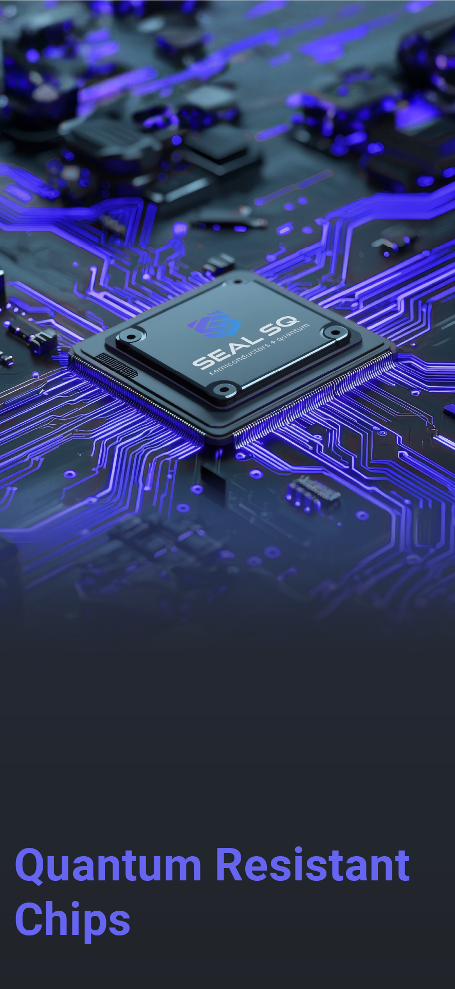
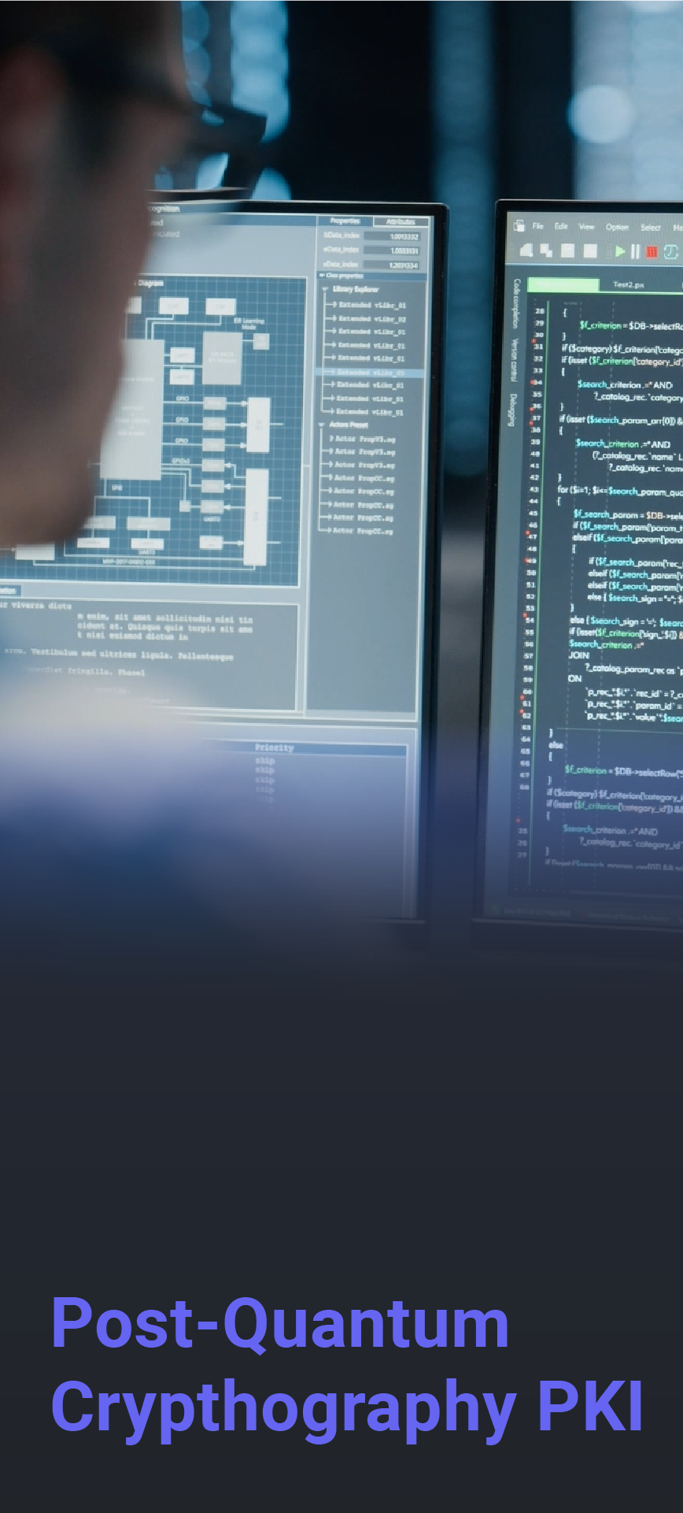
Investor Presentation
(At a Glance)
May 2025
End-to-End
Post Quantum
Security Solutions

Slide 2
About SEALSQ
SEALSQ develops and sells
Semiconductors, PKI and Post-Quantum technology hardware and software products
SEALSQ Corp.
Established | 1998 (acquired by WISeKey, parent company of SEALSQ in 2016 and reorganized in 2022)
Headquarters | France
Employees | ~60 total
 | ~25 R&D focused
Client base | 30+ countries
Patents | 118 security related
Certifications
Data as of May 2025
Nasdaq listed | May 2023
Ticker symbol | LAES
Shares Outstanding
Ordinary Shares | 114.5 Million**
F shares * | 1,499,700 (plus 77 warrants)
Stock price | $2.44/share
Market cap | $280 million
* In terms of dividend rights, 1 F share is equivalent to 5 Ordinary shares ** Data as of May 14, 2025
2

Slide 3
SEALSQ: Investment Highlights
Major Initiatives
Four major strategic initiatives to drive growth and profitability in 2025 and beyond
Launch of post-quantum chips
Expand global presence through Open Semiconductor Test and Personalization (“OSPT”) Centers
Investment into quantum companies
Satellite connectivity in collaboration with WISeSat.Space
Investing in the Future
Made significant progress in strategic transformation to post-quantum market leader.
Further expanded global client base with a focus on increased presence in U.S.
Introduced a variety of new products and services; taping into new revenue streams.
R&D investments; ambitious roadmap to launch next generation post-quantum chips in 2025.
Targeting Acquisitions
In exclusive negotiations to acquire IC ALPS, an ASIC design and supply specialist based in Grenoble, France.
Strong Cash Balance
$85M at 12/31/2024
R&D Investments
Continued investments in post-quantum chips
Investing in Start-ups
$20M Allocated
Targeting Acquisitions
In exclusive negotiations with IC ALPS

Slide 4
SEALSQ at a Glance
One-stop-shop provider
Offering a fully integrated vertical suite of microcontrollers and trust services
Securing any kind of connected devices and systems
Customer Benefits
The only digital security company acting as…
OEM
Achieve easy, fast & cost-effective product compliance with major standards (Matter, US Cyber Trust Mark, FIPS, CE...).
Ensure product and data Integrity, Authenticity and Confidentiality.
Securely provision devices with trusted identities on premises or remotely at any scale.
Operators & Service Providers
Easily and securely manage assets & users identity lifecycle at any scale.
Securely collect data from endpoints (sensors, devices, gateways).
Connect with sensors anywhere on earth using pico-satellite connectivity.
Full range of FIPS & Common Criteria Certified Secure microcontrollers.
A managed PKI-aaS platform combined with trusted hardware provisioning services.
European independent Root-of-Trust featuring a Matter PAI and WISUN accredited Root of Trust.
A cutting-edge R&D roadmap to develop certified chips running Post-Quantum algorithms and a Post Quantum Root of Trust.
Brands
Prevent counterfeiting & enable authentic Consumer Engagement.
Mint device identities into trusted blockchains creating NFTs.
4

Slide 5
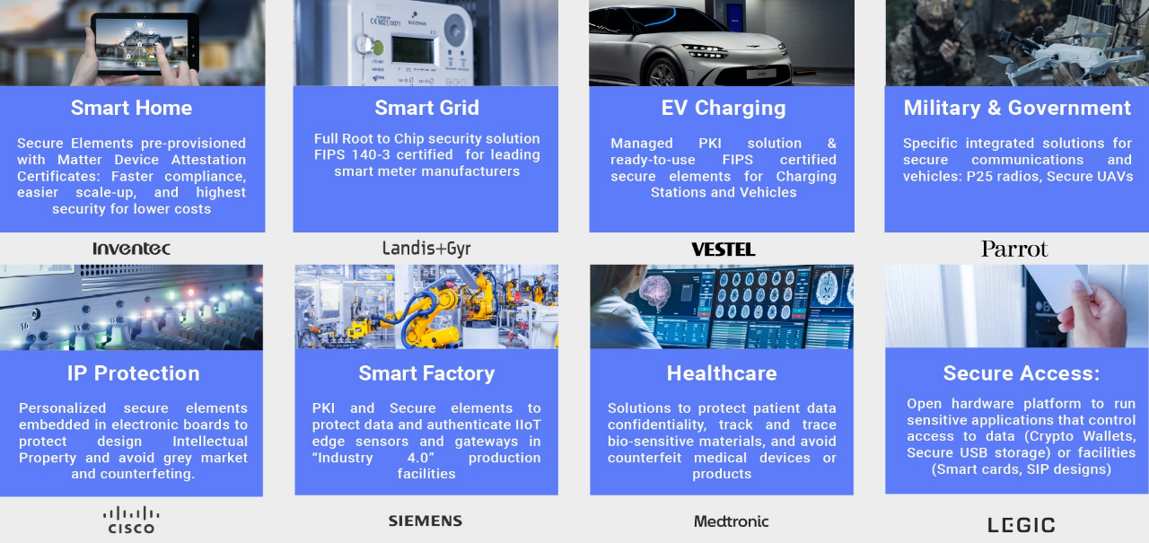
Use Cases: Markets We Serve
5

Slide 6
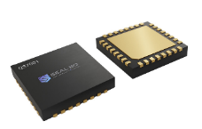
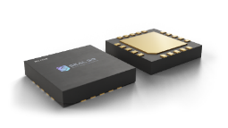
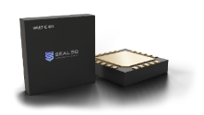
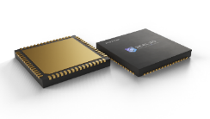
SEALSQ Semiconductor & Embedded Software
APPLICATIONS
Post Quantum Chips
Secure Storage
Access Control
Custom Application
TPM: PC, Tablets, Industrial
CCEAL 5+ RISC V Quantum Resistant Hardware platform with an optional TPM Stack firmware
MS600X FAMILY
Secure Storage
Access Control
Custom Application
CC EAL 5+ Certified Secure Controller family delivered with SDK for OS development
VaultIC FAMILY
CC EAL4+ & FIPS 140-3 Certified Secure Controller family with Embedded Firmware designed for IoT strong authentication & secure com’ channel
IoT Security
Device to Device Auth.
Device to Cloud Auth.
SCR FAMILY
POS terminals
Portable readers
NFC enabled devices
Full range of chips to build Smartcard readers

Slide 7
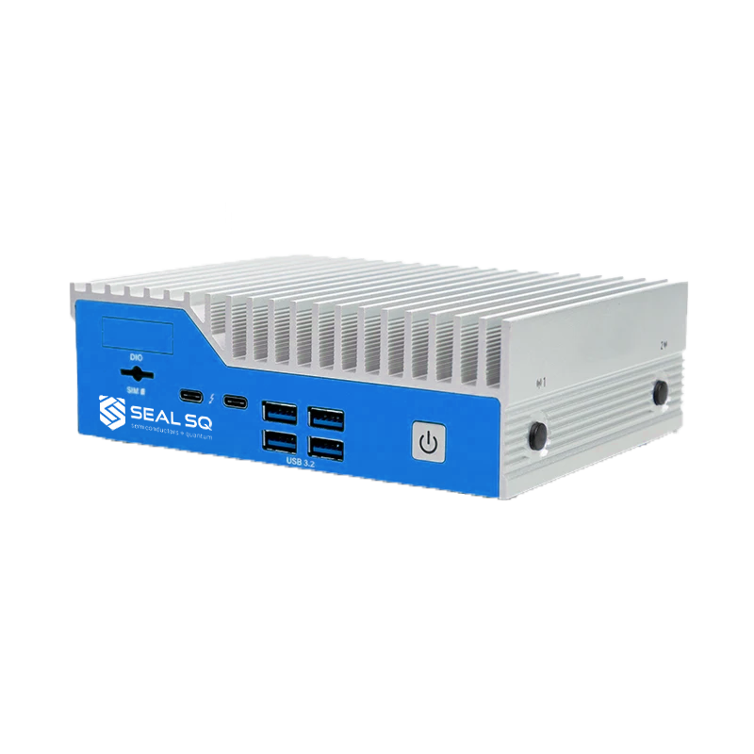
SEALSQ Quantum Resistant Trust Services
In 2024, NIST finalized the selection of several quantum-resistant cryptographic algorithms to be used as standards
(for instance, Crystals-Kyber or Crystals-Dilithium)
SEALSQ has developed a Quantum Root-of-Trust and is…
Using these cutting-edge algorithms within its PKI services.
Can operate seamlessly on classical hardware, ensuring compatibility with current devices and systems

Slide 8
Value Proposition & Key Differentiators
Post-Quantum Technology
Digital Security PURE Player
Customization / ASICS
Quantum-resistant chips in 2025, and post-quantum algorithms already running for PKI
We focus only on security, unlike our biggest hardware competitors who specialize in a broad range of embedded components.
SEALSQ can design and deliver tailor-made quantum resistant security chips to meet specific performance and security needs of large clients.
Quantum Root-of-Trust
Digital Security FULL Player
Fabless
Swiss-based Quantum Root of Trust, accredited by numerous industry ecosystems or standards such as WebTrust, Matter, GSMA and Wi-SUN
The only market player integrating all aspects of a connected device’s security from the Root-of-Trust to the Secure Elements
Cost-efficient, flexible business model focusing on the core profit area of the value chain (semiconductor design & trust services).

Slide 9
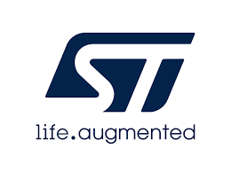
Competition Mapping on Embedded Security
(Software & Hardware)
Embedded Security Provider
IP, Software Security
(Trust Zone
& TEE)
Hardware with certified Lab
(TPM, SE)
1
2
3
Broadliner
Chip Maker
X
Ranking in Market Share
9

Slide 10
Competition Mapping on Trust Services
IoT Device Identity Provider
Pure Software Players
1
Legacy (Public CA & PKI
2
3
4
Broadliner
(Corporate / User / Device)
X
Ranking in Market Share
10
10

Slide 11
Major Strategic Initiatives
1
2
3
4
QUASAR
Program
OSPT
Centers
Investment in Quantum Companies
Satellite
Connectivity
Full range of quantum resistant semiconductors to be launched in 2025
Establish High-performance chip design & customization centers
20M$ Fund to invest in Quantum-Tech companies
Cost-effective IoT solutions for industrial applications
11

Slide 12
Investment roadmap
Target to complete acquisition in Q2 2025
(Due diligence in progress)
+ $20M Allocated to
startup investments in
Quantum computing
Quantum-as-a-Service (QaaS)
AI-driven semiconductor technologies
On-demand ASIC/SoC design and supply company
100+ experienced design engineers based in France (Grenoble & Toulouse)
Established long-term customers in healthcare, automotive & industry 4.0
Listed as recommended design partner by major foundries (TSMC, Intel, Xfab, OSRAM)
First investment already completed
Quantum Software-as-a-Service

Slide 13
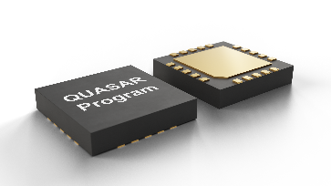
SEALSQ QUASAR Program
New Secure Chip
New PQ CRYTPO Engine
Firmware Update
RISC-V CPU
A new “Power engine”
2x faster than competition
KYBER
DILITHIUM
Fault Resistant Firmware Loader
Adaptation / Customization
at software level
13

Slide 14
Semiconductor Design & OSPT Centers
OSAT Centers
SEALSQ offers countries the ability to develop their own OSPT Centers through Public-Private Partnerships (PPP).
OSPT Centers focus on local manufacturing to meet the highest standards of security and certification like Common Criteria and NIST.
Governments, including the US and EU, are currently establishing incentives to increase supply chain resilience, emphasizing the critical timing of SEALSQ’s initiative.
France
Established
United States
Under Negotiation
Spain
Asia / Middle East / Other
14

Slide 15
Satellite Connectivity
In Collaboration with WISeSat.Space
SEALSQ, in collaboration with WISeSat.Space, are developing the first cost effective and secure IoT connectivity solution anywhere on Earth, using picosatellites and low-power sensors.
Current Problem
SEALSQ Solutions
Costly connectivity gap for a growing number of connected devices.
Global cost-effective solutions for a wide variety of applications including livestock, wearables, agriculture, industrials, tracking, to name a few.
~80%
Terrestrial connectivity gap
Use Cases
Smart Agriculture & Farming
Water management & optimization, livestock location & illness detection, analytic predictions
+25B
IoT connected devices (2030)
Logistics with Smart Container
Traceability, food chain audits, tracking
Costly, Inefficient & Complex
Current solutions
Infrastructure
Galvanic corrosion, voltage & current, vibrations

Slide 16
FY 2024 Financial Overview
As expected, 2024 was a transitional year given:
Excess inventories at legacy customers
Customers and prospects awaiting availability of next-generation chips
Impact of global economic slowdown
FY 2024 performance was reflected of this slowdown, but also of the resilience of SEALSQ to adapt to ever changing technology standards.
The Company is well positioned to capitalize on pre-shortage demand from legacy customers and new business opportunities, expected to materialize in 2025.
$11M
Revenue
FY 2024 (unaudited)
$85M
cash reserve
at December 31, 2024
Entirely clean
balance sheet
no warrants / no convertible debt
$5M
R&D Investments
In FY 2024
$7.2M planned for FY 2025

Slide 17
2025 Outlook
Bookings +80%
vs. same time in prior year
$93M pipeline
Potential contracts
OSPT projects
At least one agreement expected to
be signed in H1 2025
>80 active engagements
On new post-quantum TPM product opportunities

Slide 18
Strategy for 2025 and Beyond
Quantum Roadmap $20M investment in multiple Quantum companies Goal Identify opportunities to integrate our technologies and enhance our Quantum Roadmap
Expand
US Presence
OSPT projects
More agreements expected to be signed in the coming years
Post-Quantum TPM Opportunities

Slide 19
Contact Us
SEALSQ Corp. Carlos Moreira Chairman & CEO info@sealsq.com
Investor Relations (US) The Equity Group Inc.
Lena Cati Tel: +1 212 836-9611
lcati@equityny.com

